Slide 1
Computer-Aided Software Engineering
(CASE)

Slide 2
Introduction
Software development is complex process, which includes various activities, tools, methodology, and technology.
The development of faster, better and cheaper product has been a challenging issue for practitioners.
Automated tools can help to fulfil such needs of stakeholders.
Computer-aided software engineering (CASE) is a tool support to automate the SDLC activities.

Slide 3
  Computer-Aided Software Engineering (CASE)
CASE is a tools support for software development, project management, and maintenance activities.
It is the integration of automated software-based modelling tools into the software development process.
It is software tools for enterprise support consisting of project management, systems development, documentation and maintenance.
These tools are well tested which assist to produce desired results and uncover flaws at any stage of development.

Slide 4
  Computer-Aided Software Engineering (CASE)
CASE tools support various developing methodologies such as structured, process life cycle, object-oriented, rapid applications development, prototyping and joint applications development.
These tools include integrated development environments, data dictionaries, and tools for visualization and comprehension of existing artifacts.
A wide variety of CASE tools exist to support different software development environments in an organization[1].

Slide 5
CASE Scope
Case tools are broadly used in the following areas to speed up the development process in effective way.
  Requirement engineering
  Software design
  Model generation (data model, data flow diagram etc.)
  Process description
  User interface design
  Code generation
  Test case generation
  Document generation

Slide 6
CASE Scope
  Reverse engineering
  Configuration management
  Version change control
  Project management
  Screen and report generation
  Project planning, etc.

Slide 7
  Classification of CASE Technology
The initial classification was done on the basis of programming language, structure-centered based on the concept of environment generation, toolkit environments and methods for developing software systems.
The most common classification is based on a framework, which has three parts[2]:
  Tools: Supports specific tasks in systems development such as, editing, programming and so on.
  Workbenches: Supports one or more activities of software life cycle that support a large part of the software process such as, business planning, GUI Development etc.
  Environment : Toolkits, which are integrated collections of products, language-centered, integrated, fourth generation environments or process-centered environments.

Slide 8
  CASE Tools
CASE tools are generally classified into the three categories :
  Upper CASE Tools: Support the development activities at the early stages of software development process. e.g. report and form generators, modeling tools.
  Lower CASE Tools: Deal with the implementation and integration tasks in software development. e.g. database schema generation, program generation.
  Integrated CASE Tools : Support both early and later stages of software development. e.g. repository.

Slide 9
  CASE Workbenches
CASE workbench is a set of tools that supports particular phase in software process by integrating several tools in a single application.
CASE workbenches are generally classified into the two classes :
  Open Workbenches: Control integration mechanisms are devised and the data integration protocols are open to all.
  Closed Workbenches: The control and data integration protocols are proprietary.

Slide 10
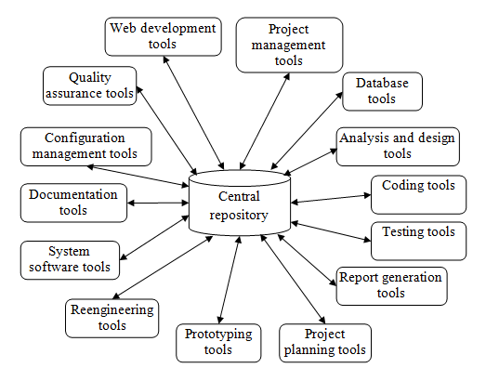
  CASE Environments

Slide 11
  CASE Environments
Software development life cycle activities can be assisted by the use of software tools.
Some of the widely used CASE tools are as follows:
  Central repository: It is a collection of stored data merged into one so that it may be shared, analyzed or updated throughout development.
  Project management tools: Used to design project schedule, activity plan, etc.
  Database management tools: The database for relational and object-oriented database management system is designed to provide support for the CASE repository.
  Analysis and design tools: Helps to produce analysis and design models of the system to be built.
  Programming tools: Compilers, editors, debuggers, programming environments, fourth generation languages.

Slide 12
  CASE Environments
  Integration and testing tools: Used for data preparation, static and dynamic measurements, simulation, and test planning.
  Project planning tools: Useful for cost and effort estimation and project scheduling activities.
  Prototyping tools: Helps to design screen layouts, data design, and report generation.
  Reengineering tools: Used during system migration from an old platform to a new platform.
  System software tools: Assist to work in desktop and network systems.
  Documentation tools: Useful to produce documentation of the work products that pave the software development process.

Slide 13
  CASE Environments
  Software configuration management tools: Assist configuration management activities such as configuration identification, version control, change control, auditing, status accounting, etc.
  Quality assurance tools: Auditing tools used to determine compliance with language standards or to ensure the quality of software being built.
  Report generation tools: These tools are used to create, modify and test prototypes of computer displays and reports.
  Web development tools: Helps to generate scripts, forms, graphics, applets, texts and various other elements for web designs.

Slide 14
  Characteristics of CASE Tools
Characteristics of an efficient CASE tool are as follows[1][2]:
  Methodology
  Flexibility
  Integration
  Validation
  Collaboration
  Repository interface
  Testing software
  Reverse engineering
  Help system

Slide 15
  Advantages of CASE Tools
The CASE tools are beneficial to achieve the following benefits[3]:
  Helpful in automating manual activities.
  Provide single design methodology.
  Saves development cost of all development phases.
  Improve the overall quality of the product.
  Highly useful in software maintenance.
  Effective requirement and configuration management.
  Increase the productivity of the software development process.
  Save manual documentation of huge documents.
  Promotes software reuse and software standardization.
  Modeling tools are helpful in designing the prototypes of software.
  Helps in improving the testing process.

Slide 16
  Limitations of CASE Tools
CASE tools have following some common disadvantages :
  Needs a lot of study and learning before using it.
  It incurs purchase and training costs.
  A very limited documentation facility in CASE tools.
  Needs regular updating with changing requirements and technology.
  Use of CASE features in appropriate places in designing a new system otherwise results into bad design.

Slide 17
  CASE Support in SDLC
Supports in automating the various activities of software development process, project management, maintenance and reengineering activities.
CASE tools that support the software development life cycle, are as below:
  Project planning and management
  Prototyping
  Analysis and design
  Coding
  Testing
  Maintenance and reengineering
  Documentation

Slide 18
  Second generation CASE tools
First Generation :
Mainly includes the prototyping tools, graphical design tools and code generators.
Limited to support for database technology and effective access mechanism.
Lacking to bridge the gap between design and application generation.
Second Generation:
More effectively used in software development.
Support for diagramming such as structure chart, data flow diagrams, state charts, data modeling etc.
Cover the life cycle automation and application generation.
Supports the adequate documentation and data dictionary.
Supports customization facility. The user can define new types of objects and connections.

Slide 19
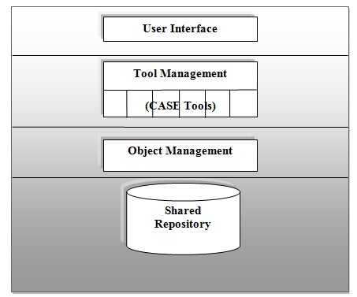
  Architecture of a CASE Environment
Figure 14.2: Architecture of CASE environment

